Slide 1
GHC Intro

Slide 2

Rigorous Qualitative Human-Centered Methods to Inform Criteria for Broadening Participation in Institutions and Organizations
Jen Strickland previously with The MITRE Corporation
Approved for Public Release; Distribution Unlimited. Public Release Case Number 25-1602. The author's affiliation with The MITRE Corporation is provided for identification purposes only and is not intended to convey or imply MITRE’s concurrence with, or support for, the positions, opinions, or viewpoints expressed by the author. ©2025 The MITRE Corporation. ALL RIGHTS RESERVED.

Slide 3
Rigorous Qualitative Human-Centered Methods to Inform Criteria for Broadening Participation in Institutions and Organizations
Jen Strickland previously with The MITRE Corporation
Approved for Public Release; Distribution Unlimited. Public Release Case Number 25-1602. The author's affiliation with The MITRE Corporation is provided for identification purposes only and is not intended to convey or imply MITRE’s concurrence with, or support for, the positions, opinions, or viewpoints expressed by the author. ©2025 The MITRE Corporation. ALL RIGHTS RESERVED.

Slide 4




Hi! I’m Jen Strickland.
Designer, Developer, Researcher, Strategist, Policy-wonk-in-training in D.C.
Recently, I served the public interest at The MITRE Corporation as an accessibility human-centered engineer supporting U.S. federal agencies. To support local government, I volunteer with U.S. Digital Response.
I’m earning a master’s in public administration at the Maxwell School of Citizenship & Public Affairs at Syracuse University.
I’m an Invited Expert with the Worldwide Web Consortium (W3C) Accessibility Guidelines Working Group. I chair a community group and am active on other working groups. If you’re looking to participate with the W3C, please reach out and I’ll help connect you.

Slide 5
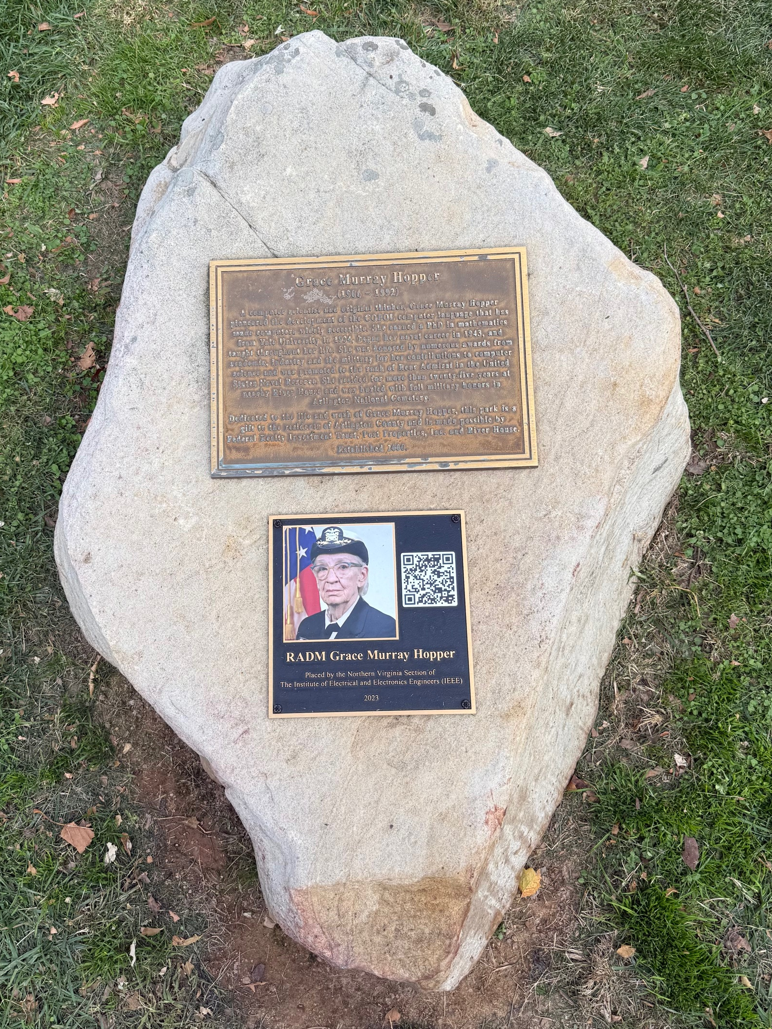
Coincidentally…
I live across from where Admiral Grace Murray Hopper lived.

Slide 6

Questions
How can rigorous qualitative methods be adapted to public policy contexts to effectively broaden participation in STEM institutions and organizations?
What if qualitative research methods are not included in public policy processes?
What qualitative methodologies can support broadening participation efforts?

Slide 7
Quote from an interview participant
“If you bring historically excluded groups into an environment that’s not inclusive, they are only surviving it.”
Rigorous human-centered methodologies must prioritize the spectrum of lived experiences and expertise, are necessary to foster robust and collaborative environments, policies, and services.

Slide 8

We need rigorous, human-centered research methods to ensure organizations, both academic and work, consider the spectrum of humanity’s lived experiences and expertise.
When it comes to the public sector, multiple perspectives must be considered for policy effectiveness.
If only quantitative data is considered, policy will fail as shown by numerous initiatives that failed to consider qualitative data.

Slide 9
New human-centered qualitative research methods…
…can reduce bias, highlight all voices, and demonstrate inclusive approaches to meet mandates of the 2022 CHIPS & Science Act to measure “ability to attract and retain a diverse and nontraditional student [and staff] population in the fields of science, technology, engineering, and mathematics.”
To meet this act’s mandate, we recruited diverse perspectives, especially historically excluded populations, noted intersectional data patterns, and used automated verbatim transcription to reduce biases from notetaker interpretation.

Slide 10
Method Development

Slide 11
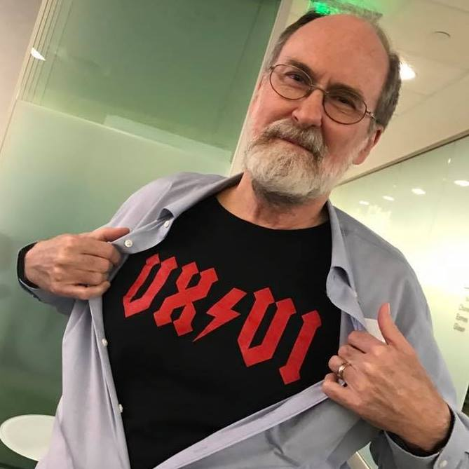
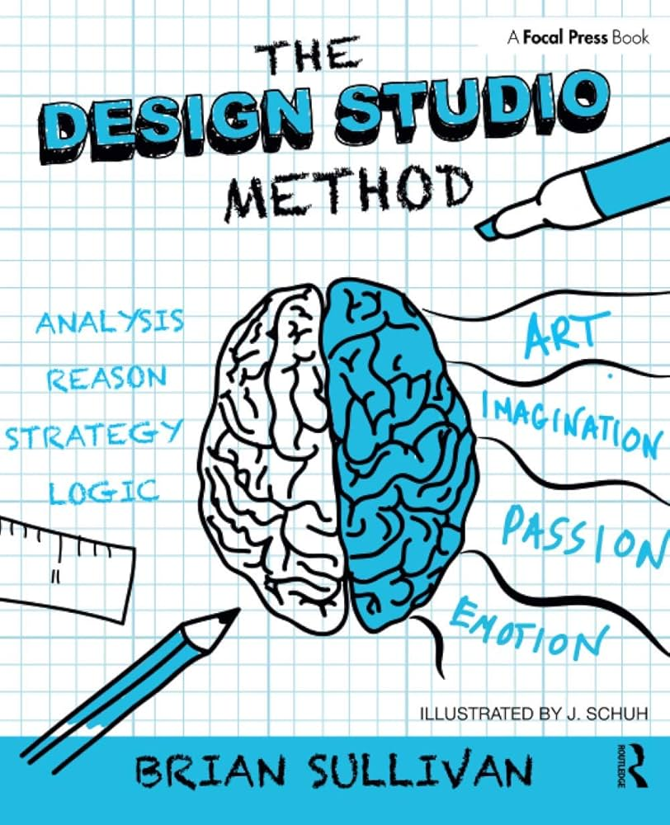




Background
From more than 25 years of experience across academia, government, private sector industry working with well-known researchers Tom Tullis and Brian Sullivan (author of The Design Studio Method), earning a certificate in problem space research with Indi Young, learning from Creative Reaction Lab and HmntyCntrd, reading numerous books…

Slide 12
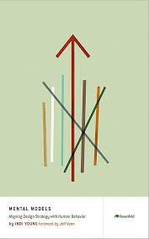
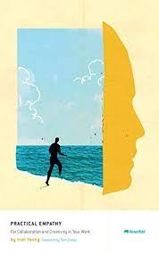
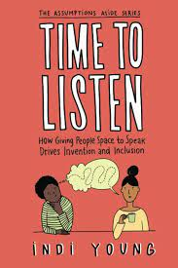
Indi Young
Author of books, such as Mental Models, Practical Empathy, and Time to Listen.
Offers an advanced training series and certification.
Listening Sessions method incorporates a purpose-driven approach to develop “thinking styles.” It was developed with a private sector perspective and doesn’t incorporate facts and opinions.

Slide 13
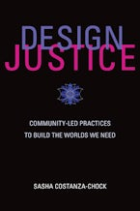
Design Justice
Framework for analysis of how design distributes benefits and burdens between various groups of people.
Design justice focuses explicitly on the ways that design reproduces and/or challenges the matrix of domination (white supremacy, heteropatriarchy, capitalism, ableism, settler colonialism, and other forms of structural inequality).
Design justice is also a growing community of practice that aims to ensure a more equitable distribution of design’s benefits and burdens; meaningful participation in design decisions; and recognition of community-based, Indigenous, and diasporic design traditions, knowledge, and practices.

Slide 14
Combining Design Justice and Indi Young’s Listening Sessions, in an adapted variation…
Using the Design Justice framework’s recruiting gaps analysis (example follows) with Indi Young’s Listening Sessions approach, adapted for the public sector to include facts and opinions, develops a rigorous, human-centered approach to qualitative analysis, applied to the CHIPS & Science Act requirement to inform criteria for broadening participation in institutions and organizations.
It builds on established practices such as environmental and literature scans, while incorporating and building upon these innovative techniques.
The method prioritizes inclusivity, minimizes researcher bias, and centers participants’ own words to generate actionable insights for public policy design and implementation.

Slide 15
The Method

Slide 16

The Steps
Strategic, thoughtful recruiting informed by gaps analysis
Semi-structured interviews follow participant’s lead
Verbatim transcript to capture participant’s own words and avoid notetaker bias
Analysis that prioritizes participant mental models and purpose, retains the person’s words
Synthesis into mental model diagrams (MMDs), a clear structure to cultivate cognitive empathy
Opportunity mapping activity to make the mental models actionable and align policymakers

Slide 17
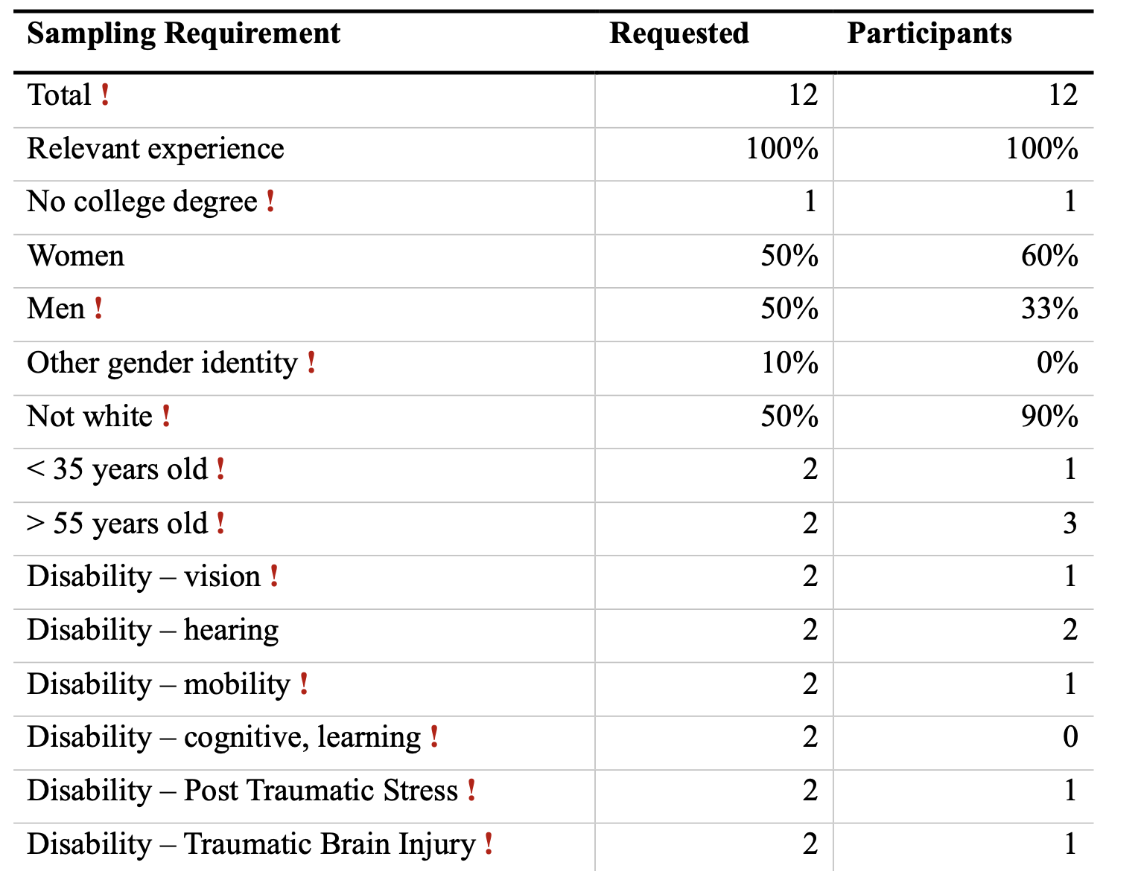
Table 1. Example of Gaps Analysis — Recruiting Sampling Requirement
The red exclamation mark (!) indicates a priority demographic based on previous recruiting gaps in lived experience.
Note: During research planning, establish recruiting goals for various demographics that are relevant for the research goal, seeking a variety of lived experiences.
Who’s involved?
Who benefits?
Who’s harmed?
Record the data on the final participants. This gaps analysis informs future research efforts to address the disparities.

Slide 18
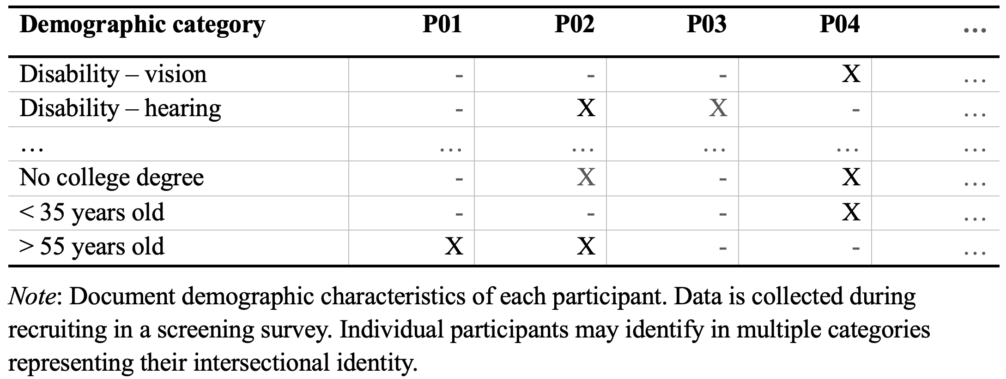
Table 2. Example of Category Analysis —Demographics of Participants

Slide 19
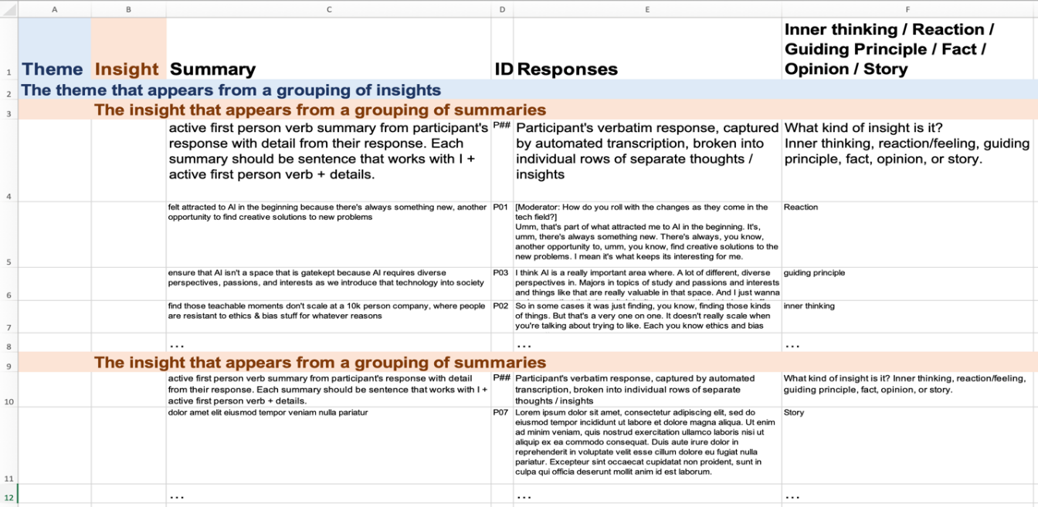
Figure 1. Specialized Template
This spreadsheet is used with Indi’s Mental Model Dataset Visualizer to generate mental model diagrams, an organized representation of the themes, insights, and summaries.

Slide 20
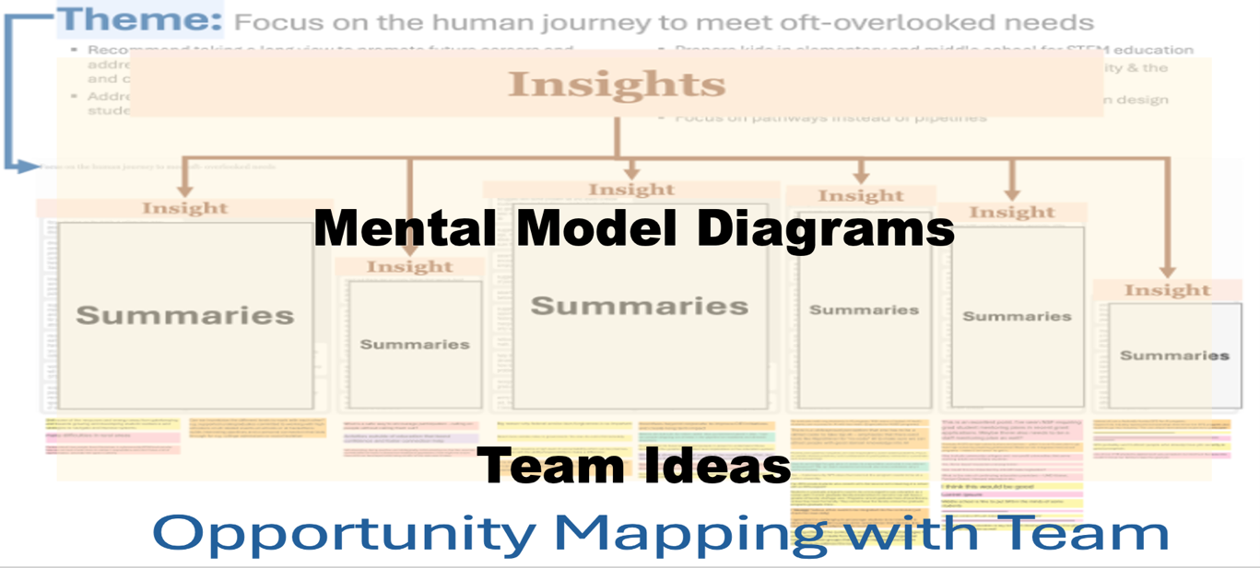
Figure 2. Example Mental Model Diagram with Opportunity Mapping
Participants’ words are “combed” into insights and themes in specialized spreadsheet
Generate mental model diagram (MMD)
MMD are used in opportunity mapping with team to cultivate cognitive empathy

Slide 21

Results
Prioritized participants’ own words to deliver actionable insights and elements that an inclusive culture or workplace needs for robust, resilient outcomes
Provided evidence from people with disabilities that agencies used to evolve physical and digital services and policies
Evolved Young’s method for public sector where facts and opinions are necessary for policy success

Slide 22




Summary
Applying principles of Design Justice in an environment resistant to concepts other than “meritocracy” can be challenging
Focusing on serving all people is key, for example, noting one in four people have a disability
Ensuring research strategy accommodates the inclusion of a broad range of perspectives will serve engineering and organization goals

Slide 23
Thank you! ツ

Slide 24

Follow Us
linkedin.com/in/stricklandjen

